Slide 1
Intelligent Auto
Python Hobbits

Slide 2

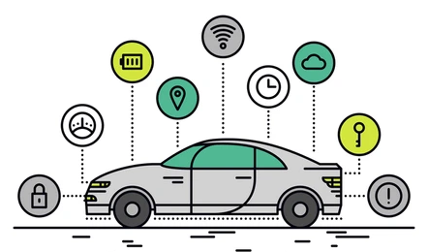
Shift from Conventional to SDV
Feature Path
Vehicle insights
Modern sensing features
Connectivity
Periodical updates

Slide 3


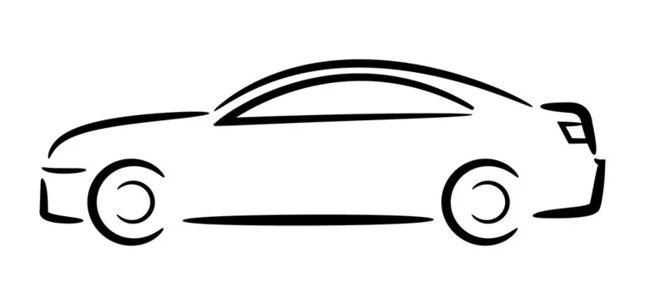
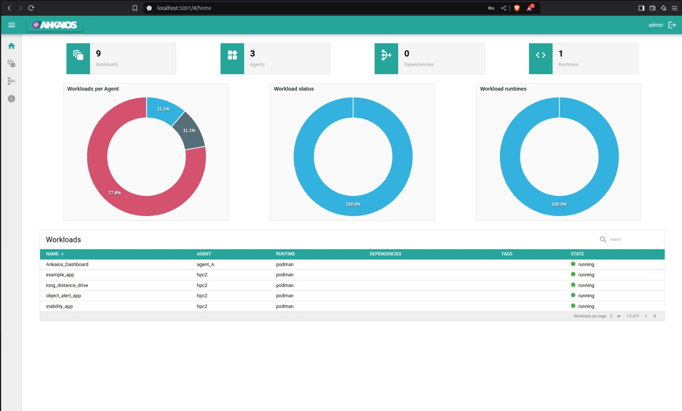

Architecture
Stability App
Vehicle Health App
Collision detection App
Long distance drive
Traffic Sign detection
Object detection
Traffic detection
Vehicle dynamics
HMI
Ankaios Dashboard

Slide 4
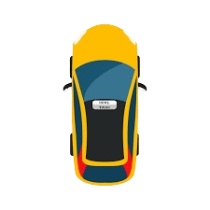

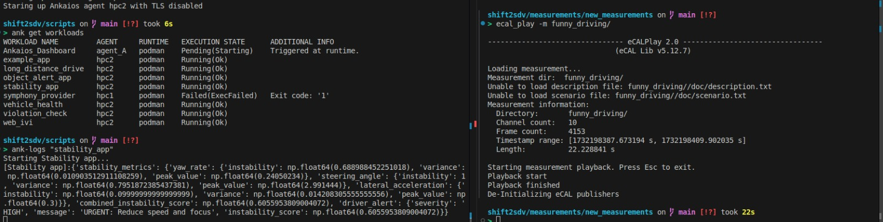
Vehicle Stability App
Yaw rate
Steering Angle
Lateral acceleration
Is the vehicle stable or not?

Slide 5
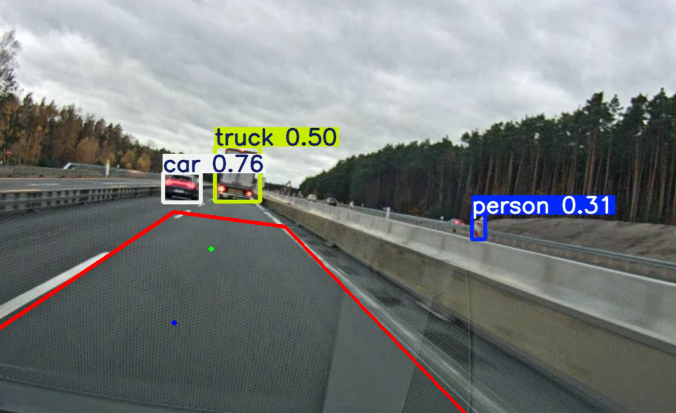
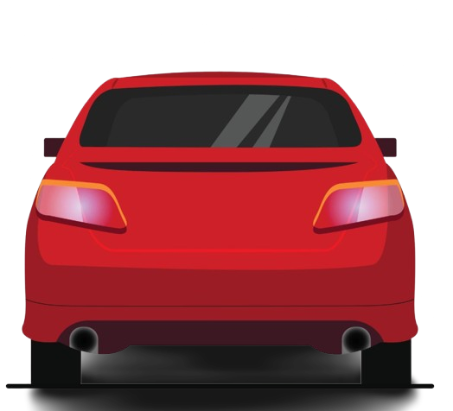
Collision detection
Safer distance
Warning distance
Region of interest in front of vehicle is splitted into 2 zones:
Safer distance
Warning distance

Slide 6
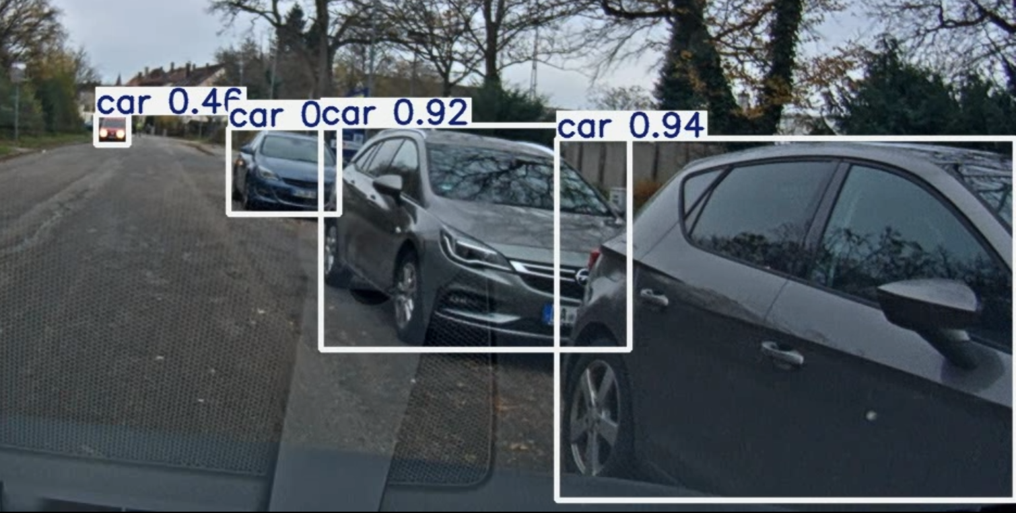
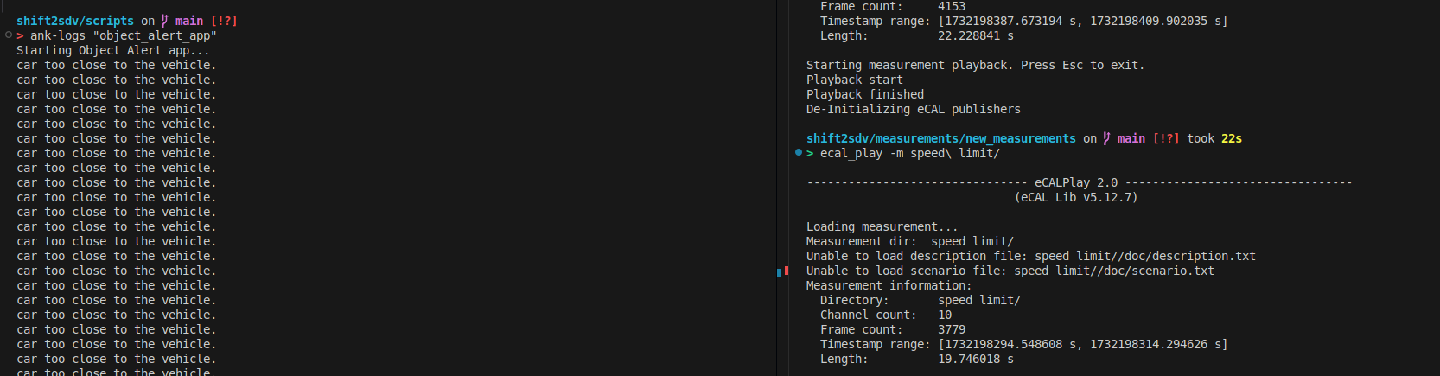
Collision Detection

Slide 7
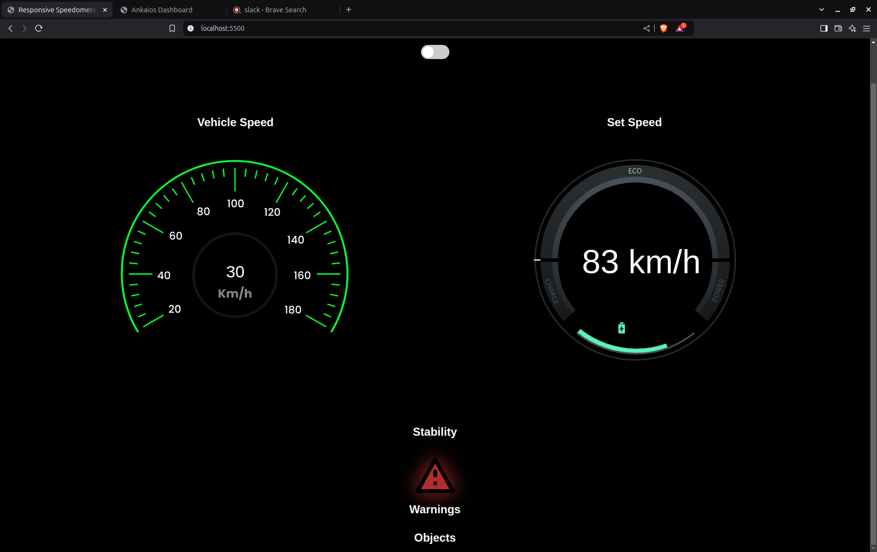
HMI - Simulated

